Slide 1
March 2017

Slide 2
MARCH MEMORY VERSE:
“I will instruct you and teach you
in the way you should go.”
Psalm 32:8

Slide 3
Children’s Church
is available during
our worship service time
for
Toddlers class: 1-4 years old
Juniors class: 5-11 years old

Slide 4
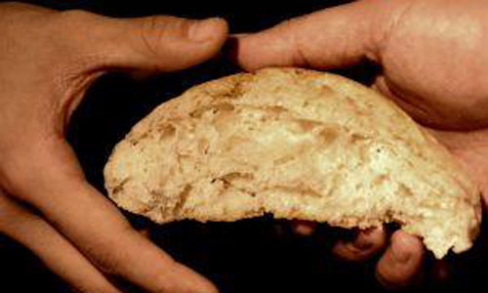
Three Loaves i Need
Mark 8:1-13

Slide 5
Light Snacks are needed for fellowship each Sunday.
Please help if you are able.

Slide 6
Today’s Thought:
“Faith is the ability to not panic.”

Slide 8
Birthday’s:
Marty Stein 3/8
Fred Ryan 3/9
Emily Fortino 3/9
Gabby Fortino 3/10
Logan Williams 3/16
Darrel Fortino 3/17
Bob Hampson 3/25
Rodney Hall 3/25

Slide 9
Fred and Shirley Ryan 3/5

Slide 10
Quarterly Mission Focus (Feb – April)

Slide 11
Read God’s Word!
The daily reading schedule is
on the bulletin table or www.mallorywesleyan.org.
Pastor’s sermons & Bible studies follow the reading plan.
God’s Word will bless you each day!

Slide 12
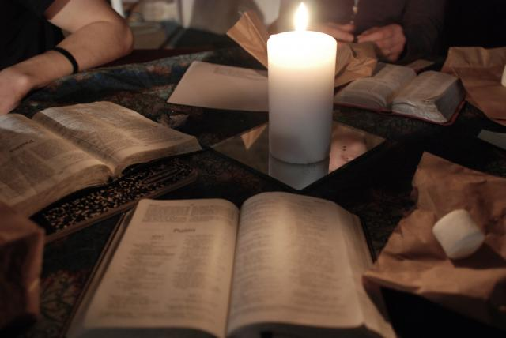
Tuesday Evening Bible Study
6:30pm at church

Slide 13
Worship Team Practice
Each Wednesday Evening
@ 6pm
in the Sanctuary

Slide 14
Next
club date
3/17 @ MWC
See Dee for more info.

Slide 15
Church Board Meeting
March 9, 7:00pm

Slide 16
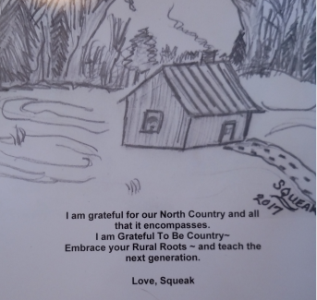
Book Signing
Author: Sandra Petrie Rose “Squeak”
March 12 after service

Slide 17
Video Series
“Behold The Bridegroom Come”
By Dick Rubin
3/12/17 at 7pm

Slide 18
Saturday, March 18
8:30 am
Good Golly’s

Slide 20
Annual Banquet
Thursday, March 30

Slide 21
NDOP Committee Meeting
April 6th at 5:00pm

Slide 22
April 23at 6:30am ~ light breakfast to follow

Slide 23
Service at 10 am

Slide 24
ON THE ROAD TO THE…..
PRAYER BREAKFAST
SATURDAY, April 1, 2017; 10AM
WEST MONROE FIRE HALL; MALTESE ROOM
Cindy Hampson and Donnalene McGinnis speaking
PLEASE RSVP TO PASTOR, CINDY, PAT, OR DEE

Slide 25
Pastor’s call to
Sacred Assembly
Sunday, April 30
Worship Service ~ 10:00 AM

