Slide 1
Welcome to Mallory Wesleyan Church!

Slide 2
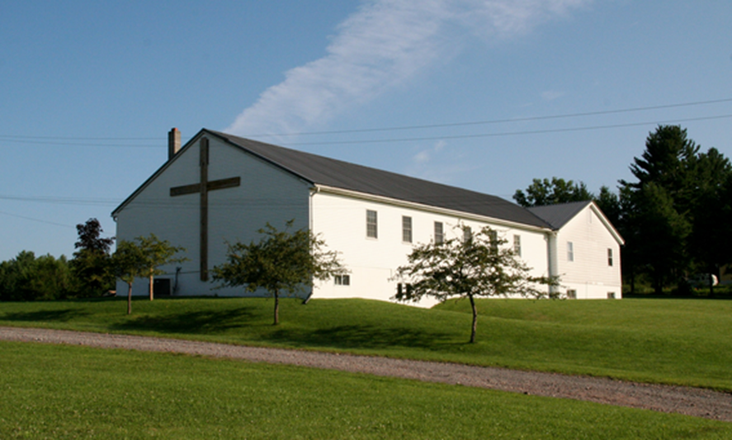
We invite you to join us during Sunday Worship Service @ 10 am, and throughout the week as we study the Word, pray, and seek God’s will in our lives.
If you have questions regarding any of our announcements or activities, please call the church 676-4792. We would love to hear from you!

Slide 4
April Memory Verse
“The angel said...He is not here; He has risen, just as He said.” Matt 28::6

Slide 5
PLEASE PRAY FOR
This Month: Caughdenoy United Methodist Church
This Week: Grace Lee Memorial Wesleyan
Beaver Dams, NY

Slide 6
Sunday Sermon:

Slide 7
Children’s Church
is available during
our worship service time
for
Toddlers class: 1-4 years old
Juniors class: 5-11 years old

Slide 8
Light Snacks are needed for fellowship each Sunday.
Please help if you are able.

Slide 9
10 Week
Sunday Night
Video Series
7pm

Slide 10
Today’s Thought:
“Deciding not to choose Jesus
is still making a choice”

Slide 12
Birthday’s:
Dick Auringer 4/14
Deanna Fortino 4/14
Glenn Hampson 4/14
Mary Jane Rettig 4/15
Randy Graves 4/15
Marissa Shoop 4/16

Slide 13
Mallory Wesleyan Church Quarterly Mission Focus:
and/or

Slide 14
Be sure to pick up the
2018 Reading Schedule
Read along with the church
throughout the year.
You will be blessed!
Sermons and Bible Studies
follow the schedule.

Slide 15
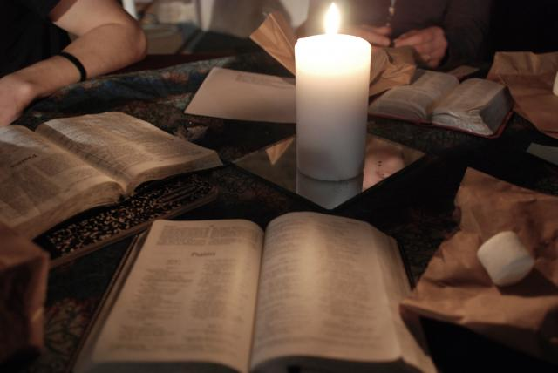
Tuesday Evening Bible Study
6:30pm at church

Slide 16
Practice;
Thursday
this week!
6pm
Sunday
9am

Slide 17
Meeting
Thursday, April 12
7pm

Slide 18
Saturday, April 21 9:00 am - NOON

Slide 19
Ladies retreat
April 27 - 29

Slide 20
Pastor’s call to
Sacred Assembly
Sunday, April 29
Worship Service ~ 10:00 AM

Slide 21
Calling all Ministry Leaders!
February 10
Due April 30

Slide 22
Hosted by: Divine Mercy

Slide 23
Please pray for
YoungLife and Wyldlife
– Central Square

